Slide 1
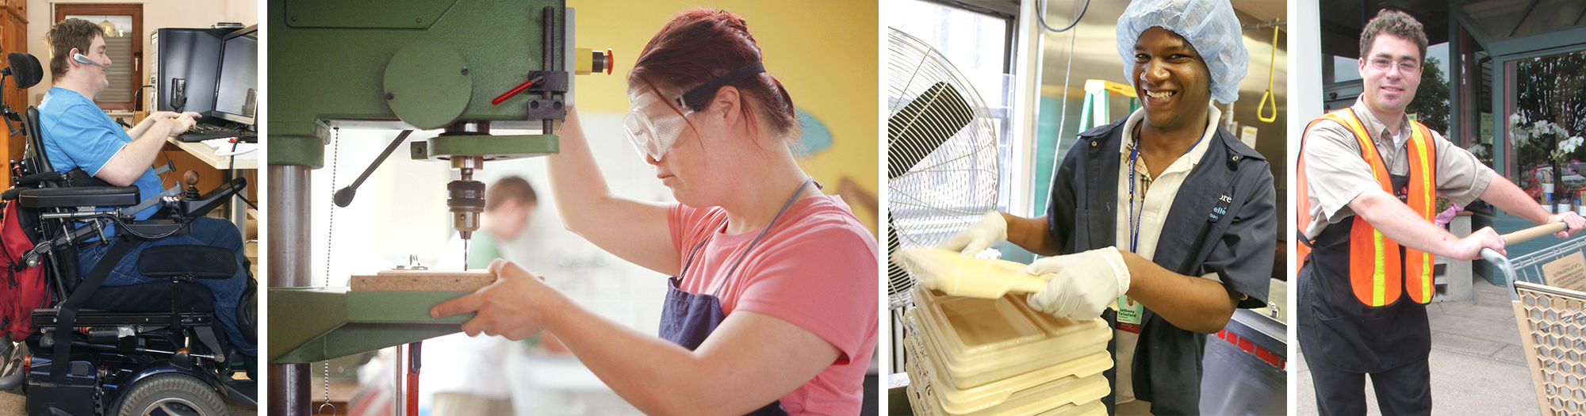


Staying Safe at Work
Teaching Workers with Intellectual and Developmental Disabilities About Health & Safety on the Job
LABOR OCCUPATIONAL HEALTH PROGRAM University of California Berkeley
and
DEPARTMENT OF HEALTH AND HUMAN SERVICES Centers for Disease Control and Prevention National Institute for Occupational Safety and Health

Slide 2
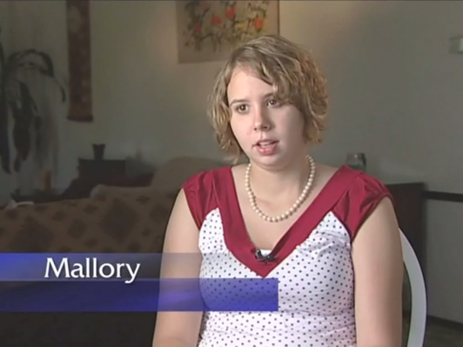
The Impact of Work Injuries and Illnesses
Click on Image to begin playback

Slide 3
Key Points of this Class
By the end of this class, you will be able to:
Recognize what can hurt you at work
Understand that workplace injuries and illnesses are preventable
Decide how to solve health and safety problems at work.
Decide what to do in an emergency.
Know the laws that protect workers on the job.
Name some of the agencies that enforce health and safety laws.

Slide 4
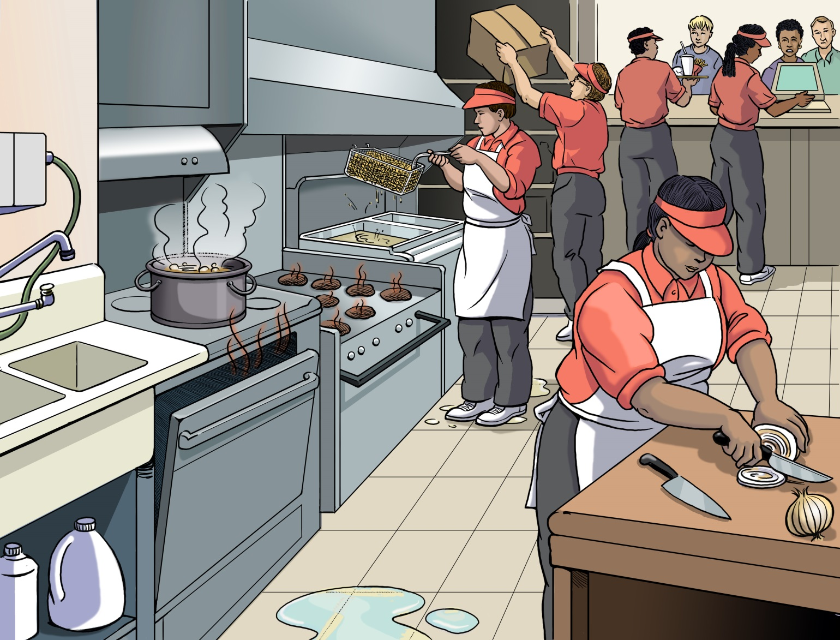
Find the Hazards — Restaurant

Slide 5
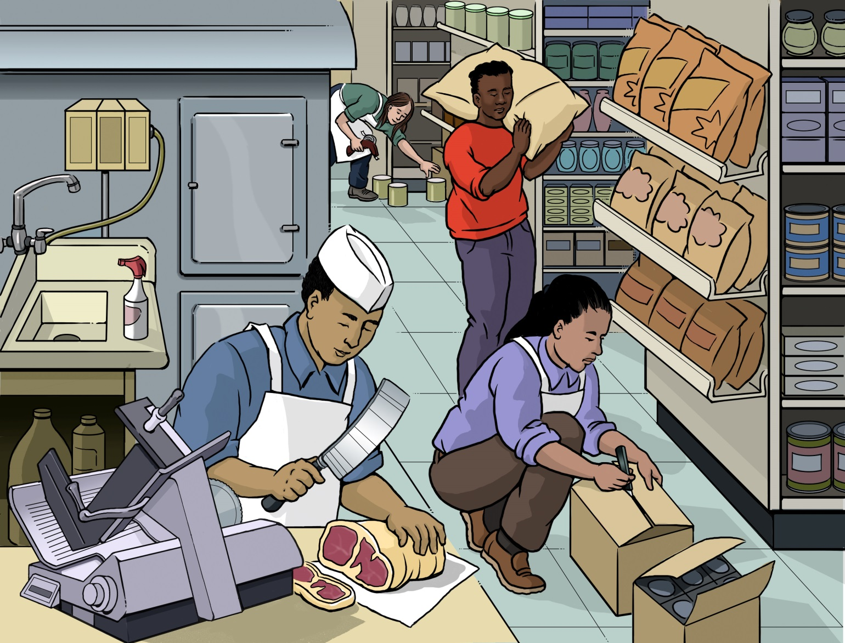
Find the Hazards — Grocery Store

Slide 6
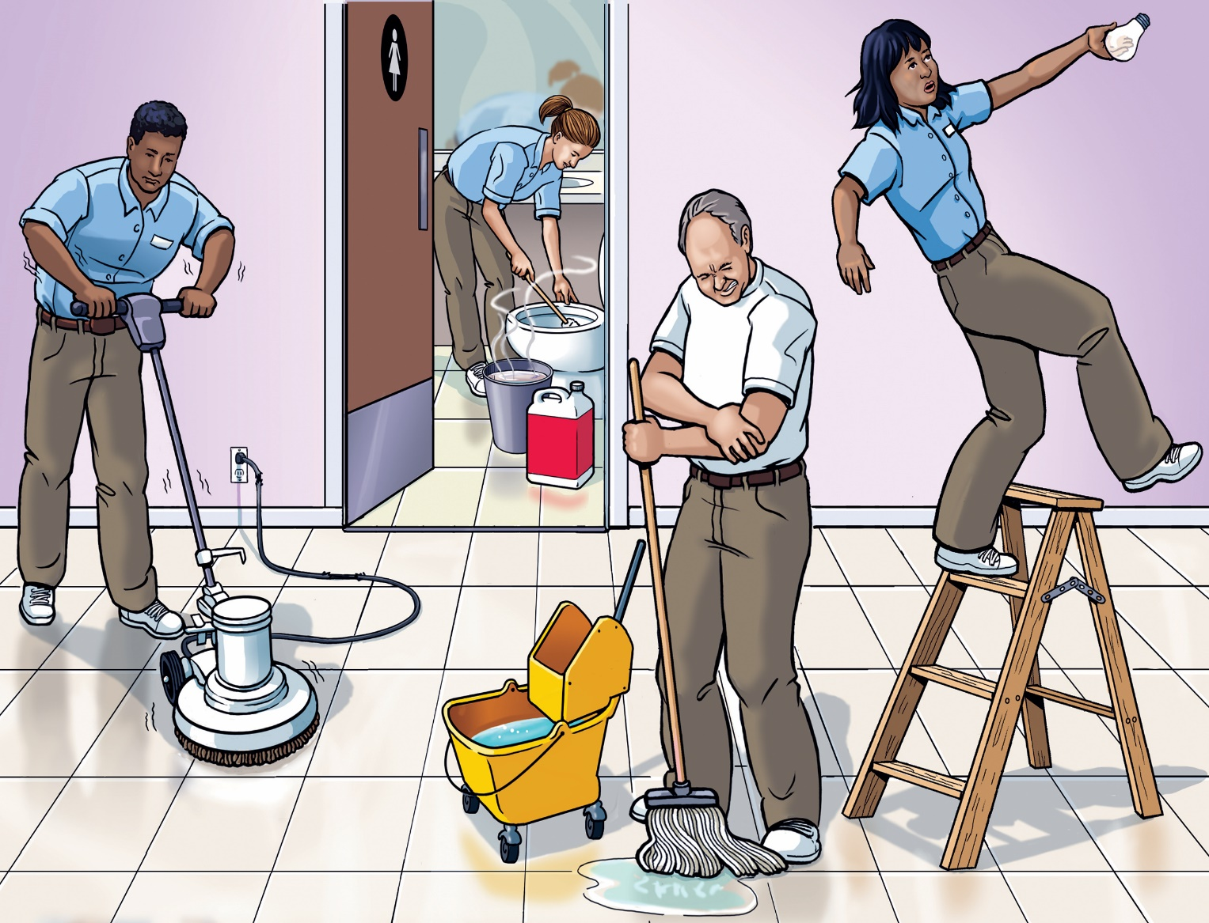
Find the Hazards — Janitorial

Slide 7
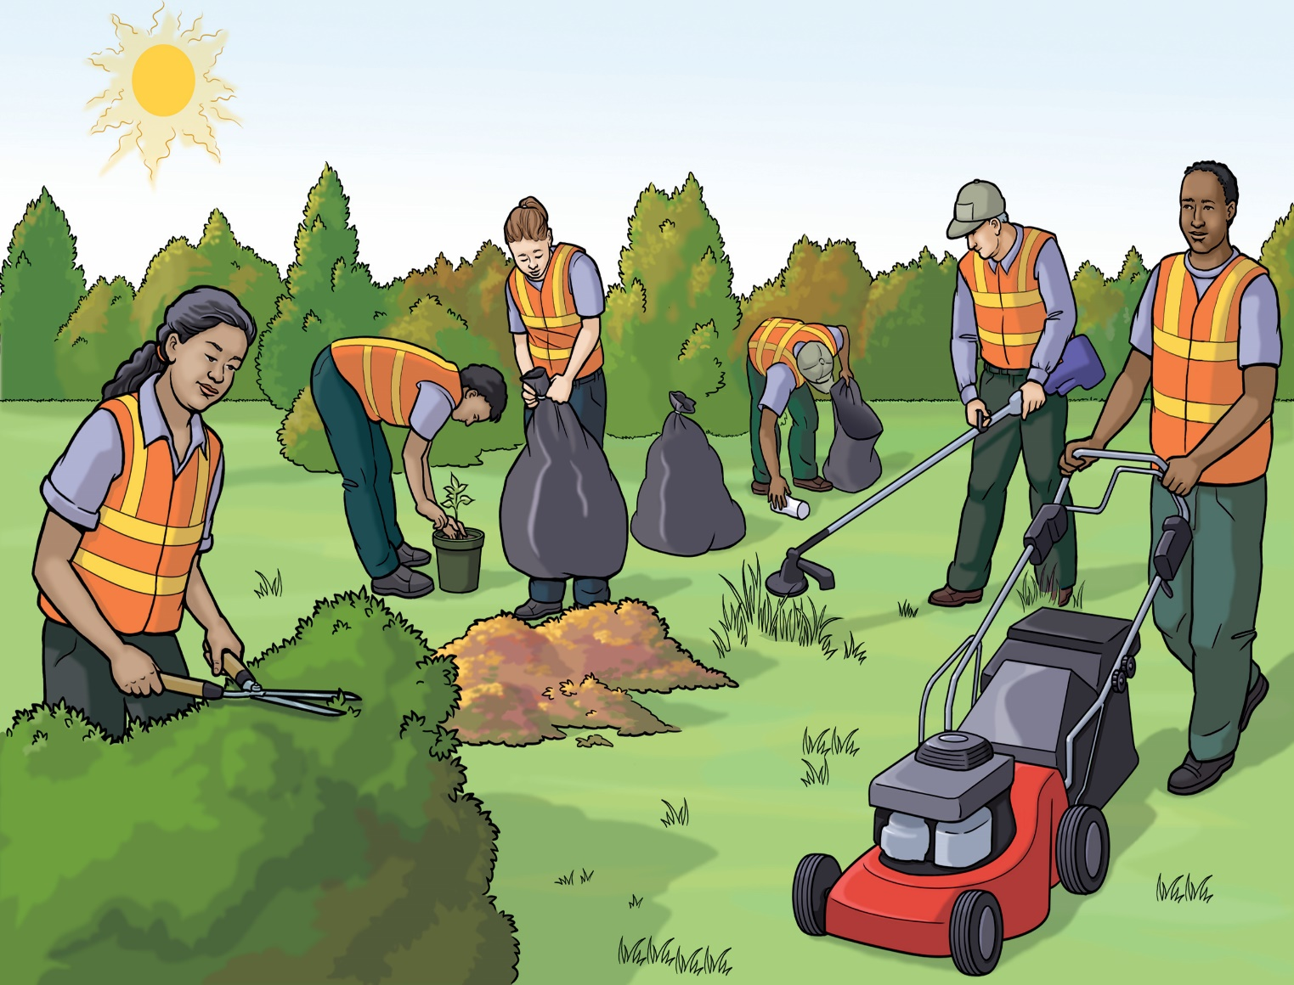
Find the Hazards — Grounds

Slide 8
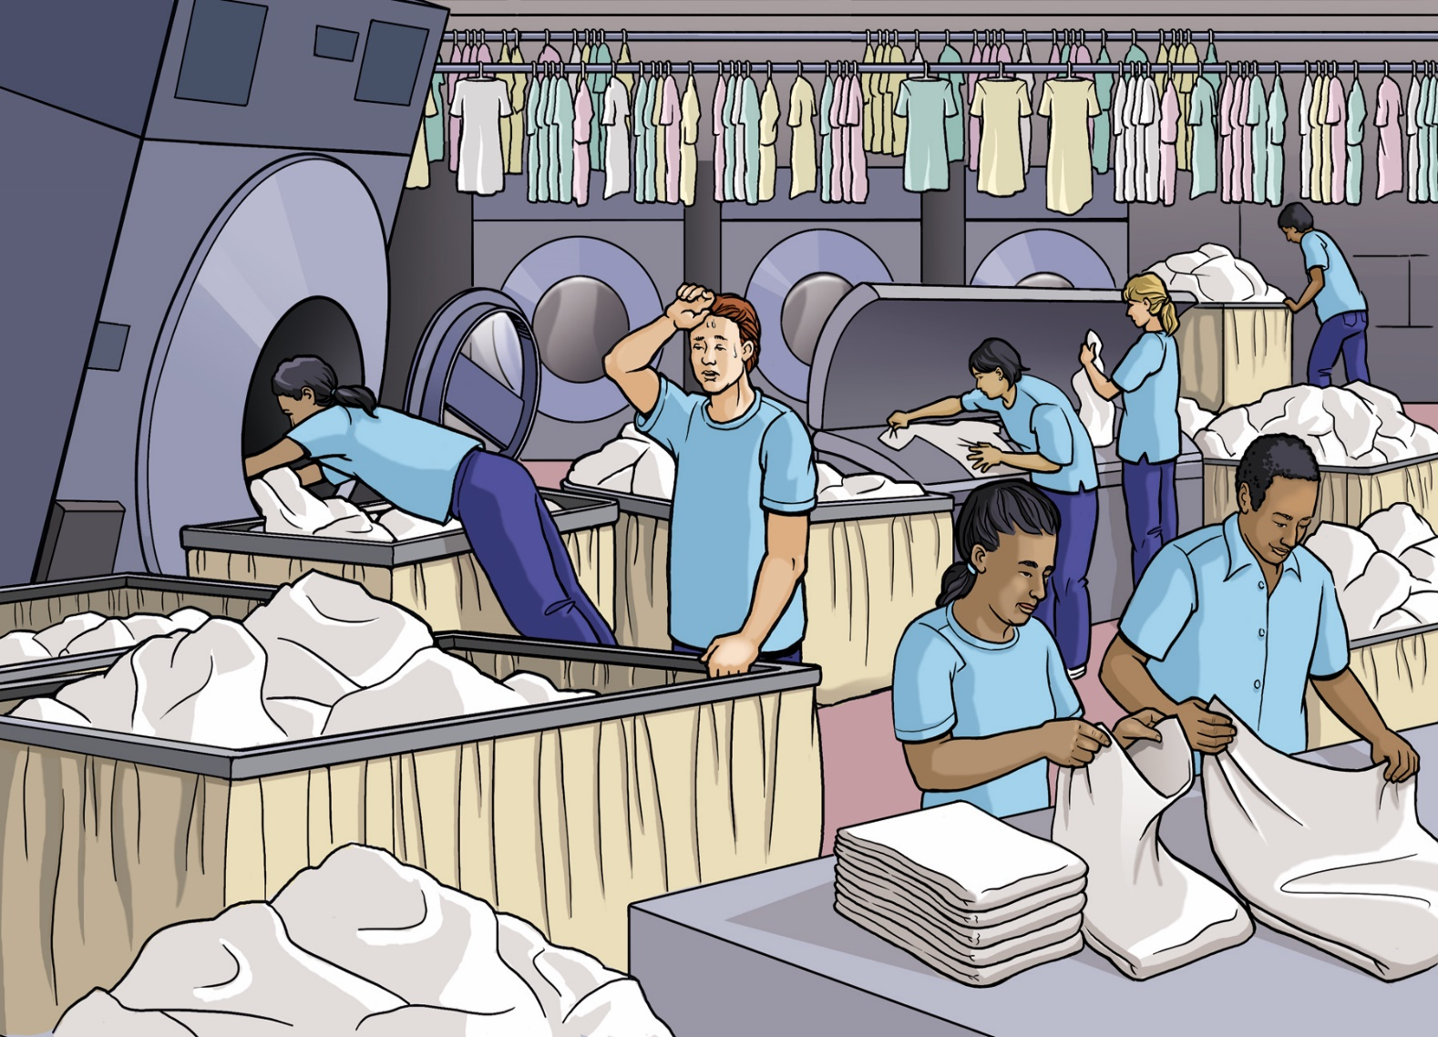
Find the Hazards — Laundry

Slide 9
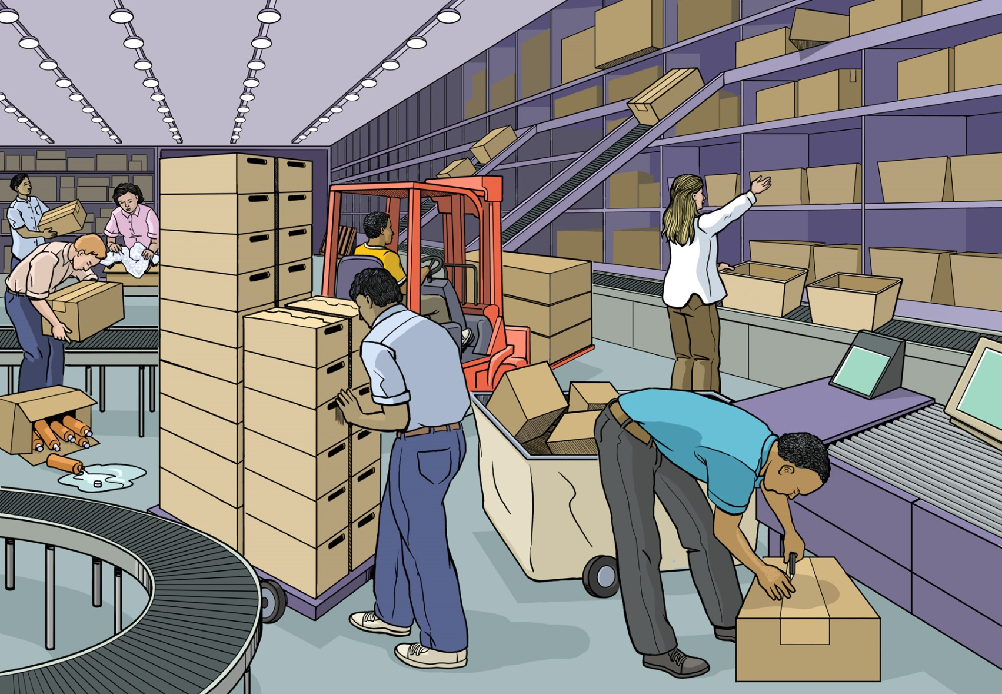
Find the Hazards — Warehouse

Slide 10
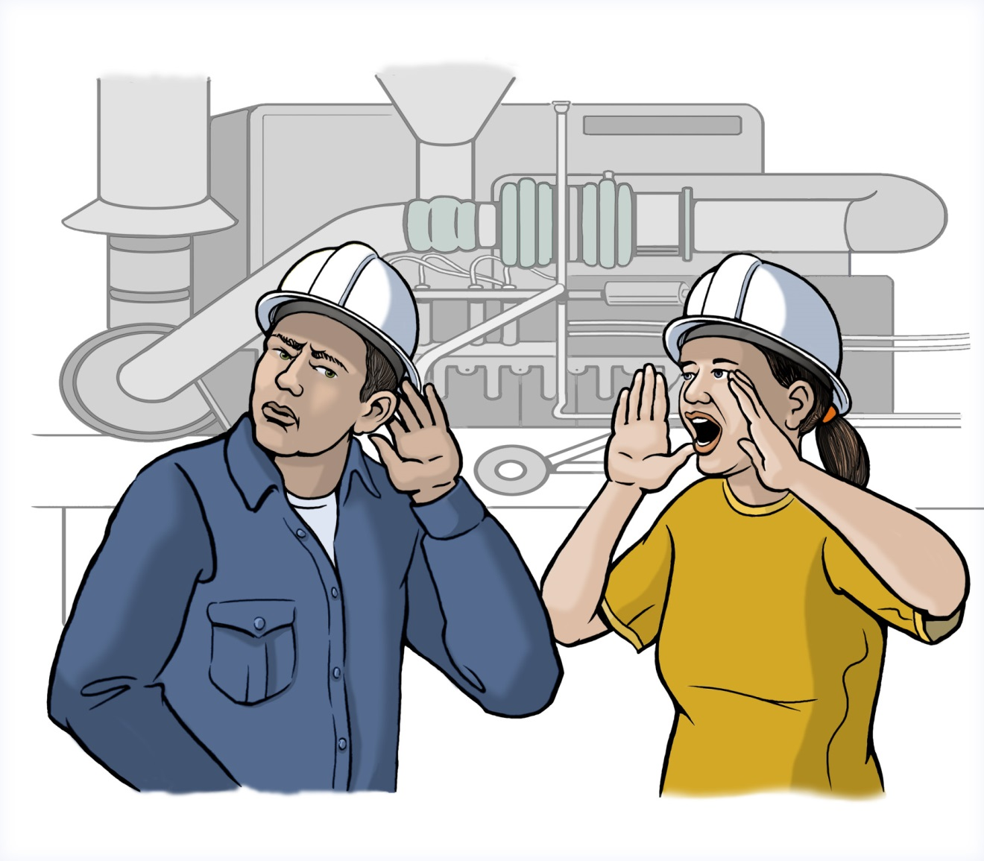
Noise Hazards

Slide 11
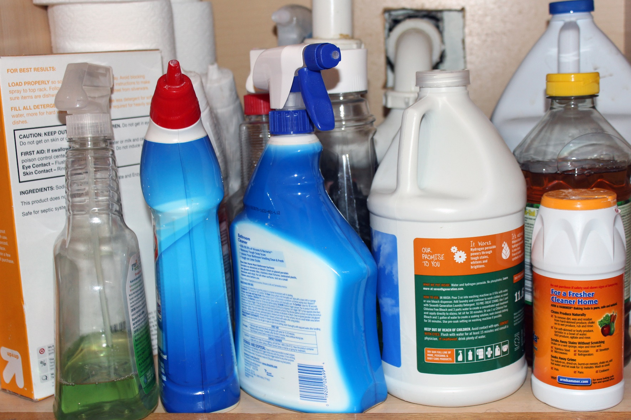
Chemical Hazards

Slide 12




What Can Chemicals Do?

Slide 13
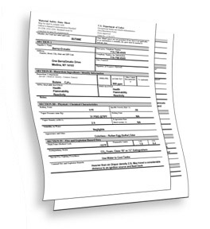
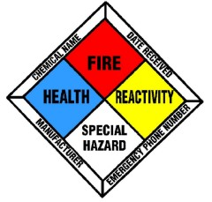

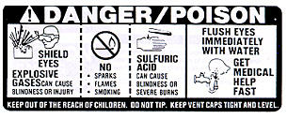
Ways to Find Out About Chemicals at Work
Ask Your Manager
Safety Data Sheets (SDS)

Slide 14
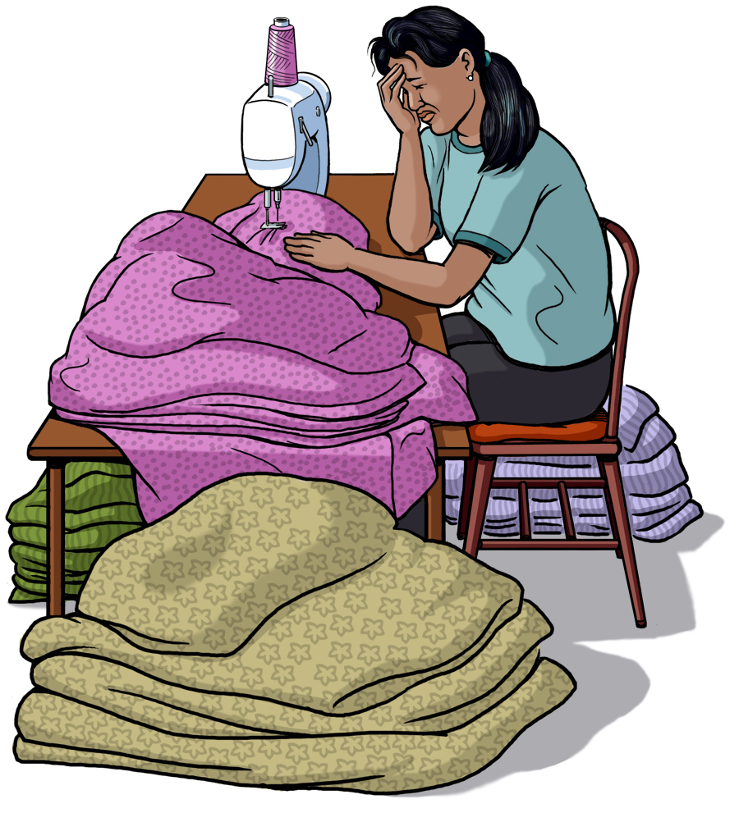
Hazards that Cause Stress

Slide 15
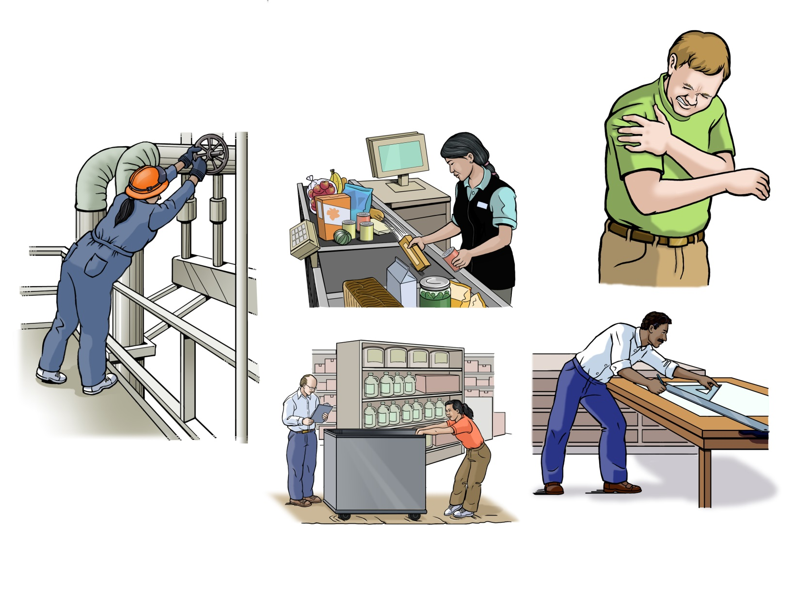
Ergonomic Hazards

Slide 16
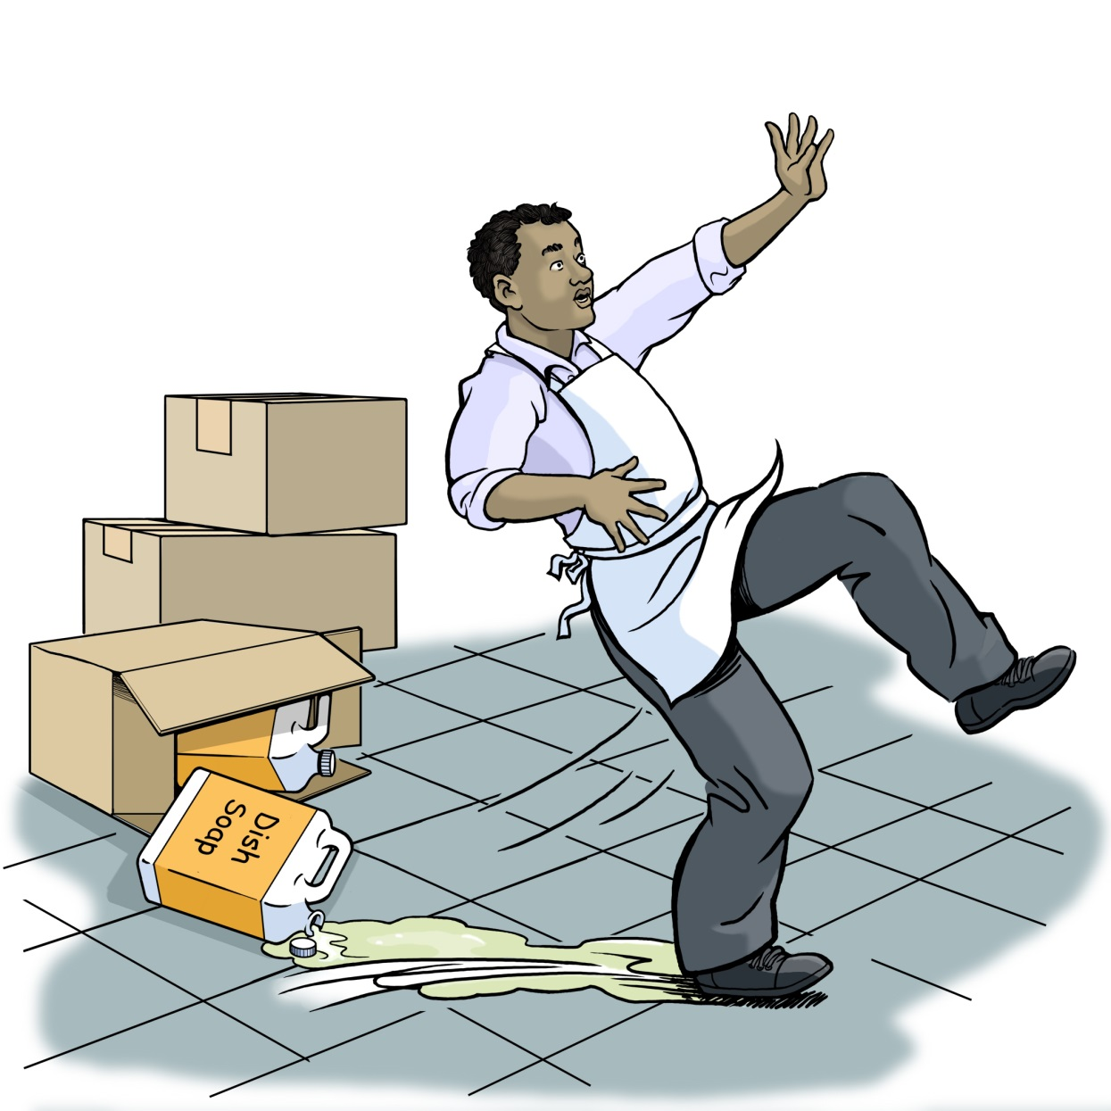
Making the Job Safer — John

Slide 17
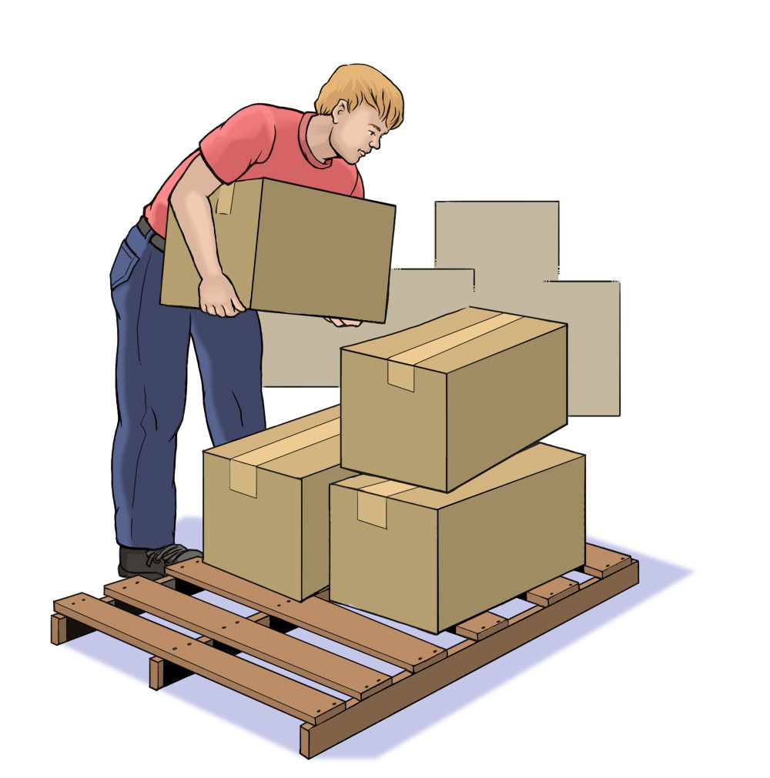
Making the Job Safer — Bill

Slide 18
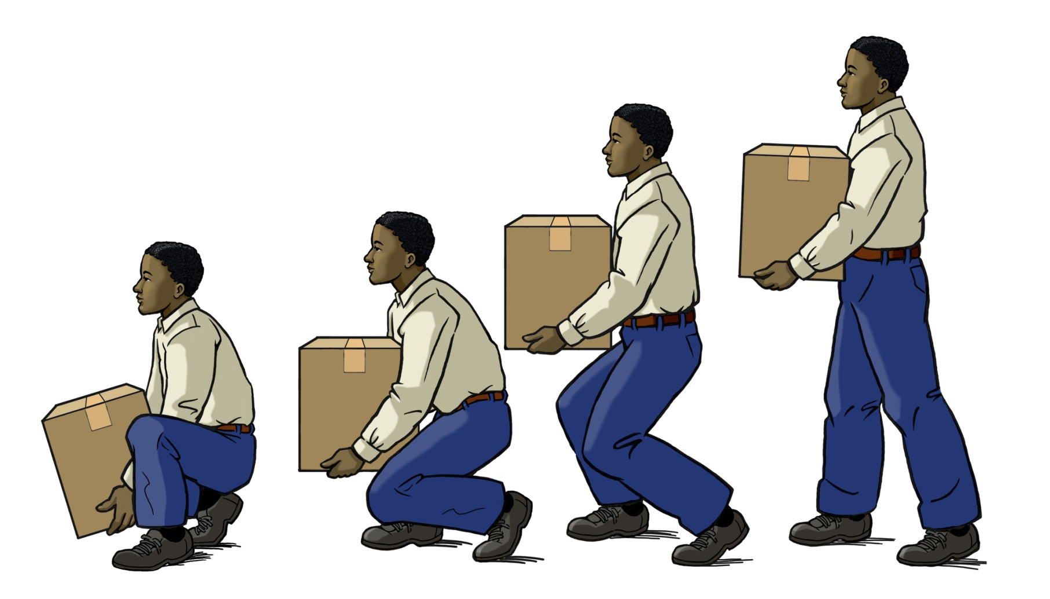
Safe Lifting Techniques

Slide 19
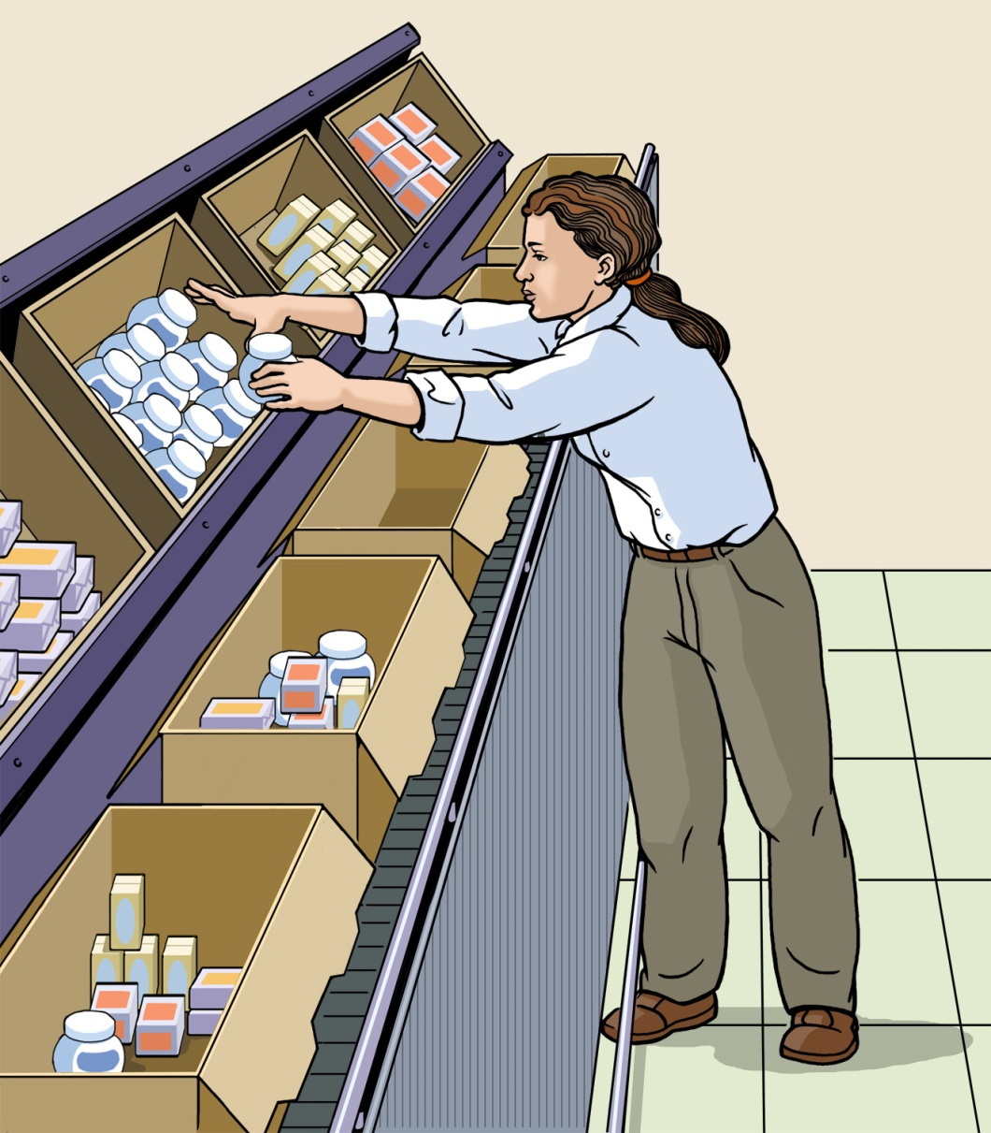
Making the Job Safer — Mary

Slide 20
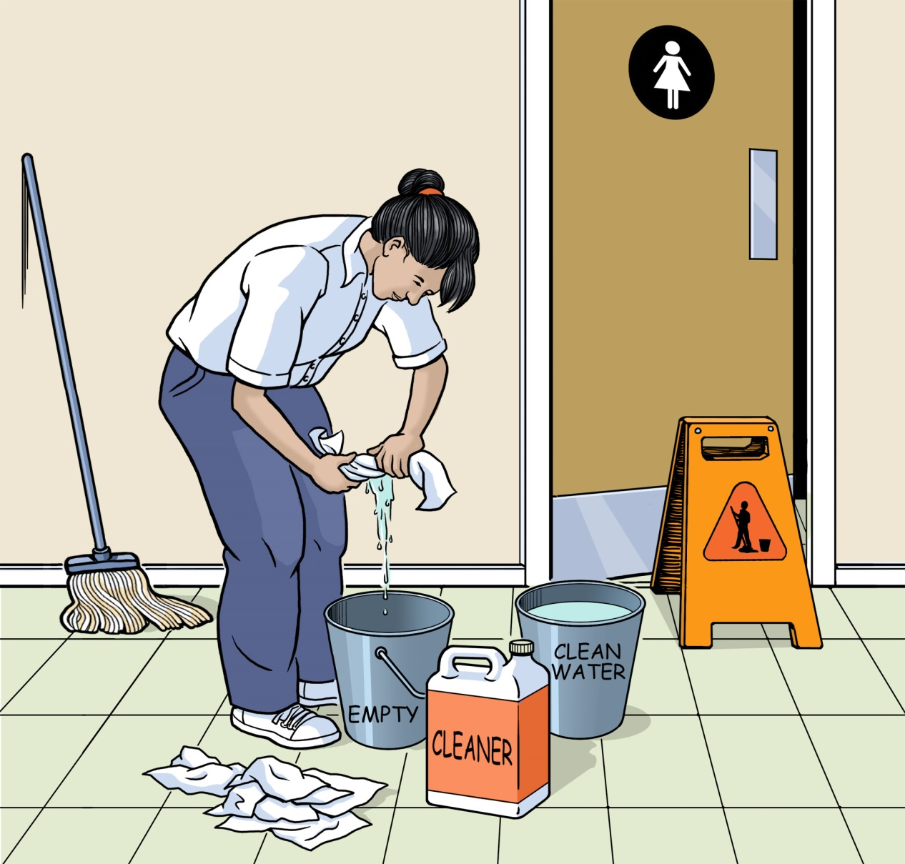
Making the Job Safer — Ann

Slide 21
Preparing for an Emergency
Look for Evacuation Maps, Routes and Exit Signs

Slide 22

Preparing for an Emergency
Know what alarms sound like and what they mean.
Practice what to do.
Know where the meeting places are.

Slide 23
Know Your Rights: Key Points
Federal and state labor laws protect workers from:
Hazardous jobs.
Working too long, too late, or too early (for workers under 18 years old).
OSHA says every employer must give workers:
A safe workplace.
Safety training on certain hazards (when required).
Safety equipment (when required).
By law, your employer is not allowed to punish or fire you for reporting a safety problem at work!

Slide 24
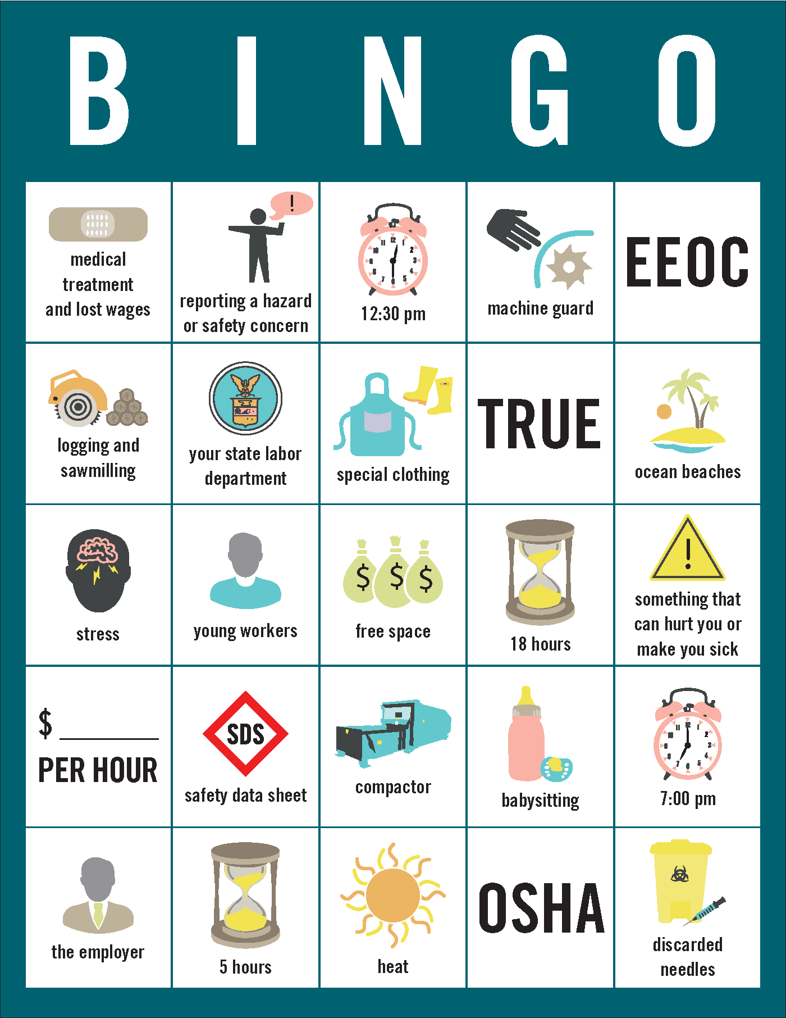
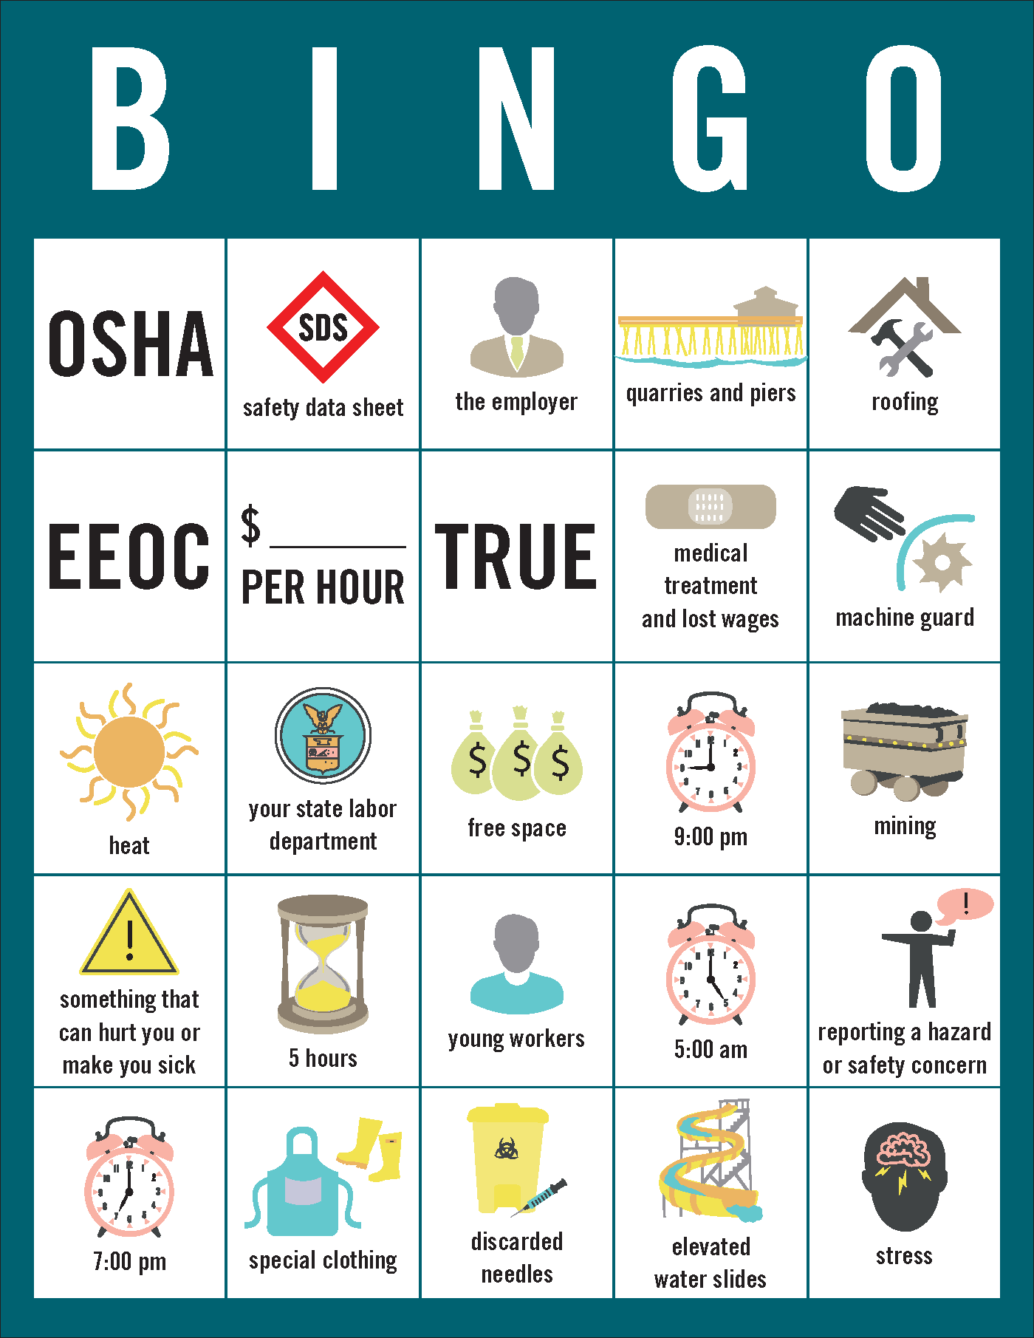
Know Your Rights
State Labor Law Bingo Game

Slide 25
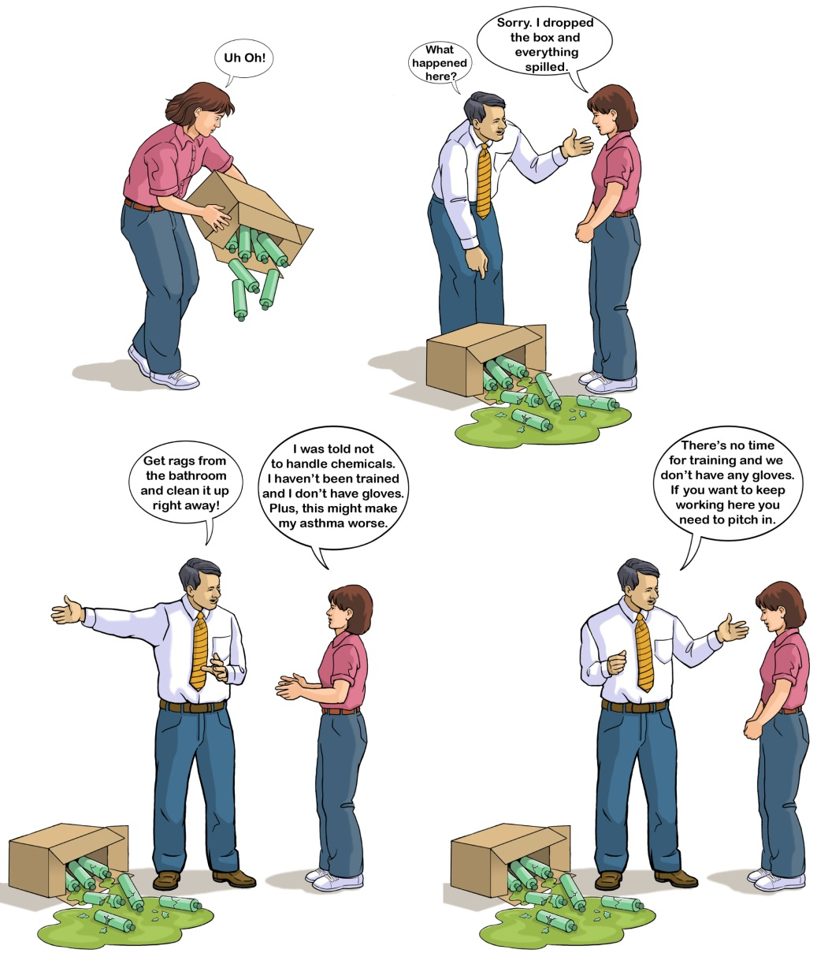
Jill’s Difficult Day at Work

